Slide 1

Statistical Analysis of Airbnb Rates in New York City
Group 29
Alexa Schultz
Amber Chiotasso
Cristonique Basden
Duyen Nguyen
Stephen McFarlane
Taylor Pitts

Slide 2
CONTENTS
Introduction
Problem Statement
Modeling Type
Dataset
Visualization
Results
Observations
Conclusion
References
Statistical Analysis of Airbnb Rates in New York City - Team 29

Slide 3
INTRODUCTION
What is the problem?
Finding appropriate rates for Airbnb hosts to charge for their listings
Why you chose this problem?
Help hosts figure out realistic and appropriate rates
Help consumers ensure they are getting a fair price
Why it is a pressing problem now?
Lost sales from unhappy renters
Many airbnb hosts have little guidance on how to price their listings
Oversaturated markets
Unreasonably priced units
Lost profits
Statistical Analysis of Airbnb Rates in New York City - Team 29
Notes:
we wanted to build a model to help airbnb hosts price their listings. A model helps hosts determine appropriate and realistic prices, and helps customers be sure they are getting a fair price based on previous data. This is a pressing issue because many airbnb hosts have little to no guidance on how to price their listings, which can lead to oversaturated markets, unreasonable prices, and a loss of profits.

Slide 4
PROBLEM STATEMENT
Problem statement
An analysis of the NYC Airbnb unit pricing can determine quickly and appropriately how to price Airbnb units according to current market demands for their particular accommodations.
Hypothesis
What are the factors that have significant influences on NYC Airbnb rates?
Solution Approach
Building a forecast model that is able to predict Airbnb rates based on the historical data in terms of locations, number of reviews, room types, and availability.
Statistical Analysis of Airbnb Rates in New York City - Team 29
Notes:
-doing this project to quickly determine airbnb prices according to historical data on their accommodations
- Most people would assume Airbnb units located in large cities would cost more than those in smaller cities? Is it really true? Or which factors influence the pricing more heavily?

Slide 5
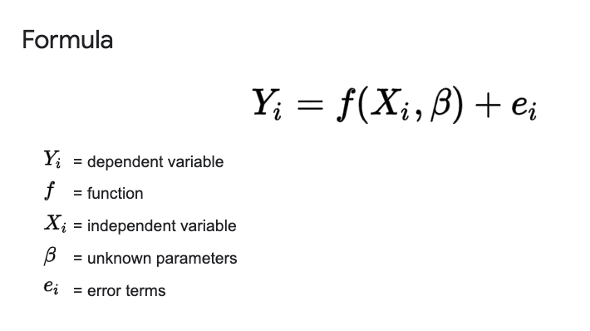
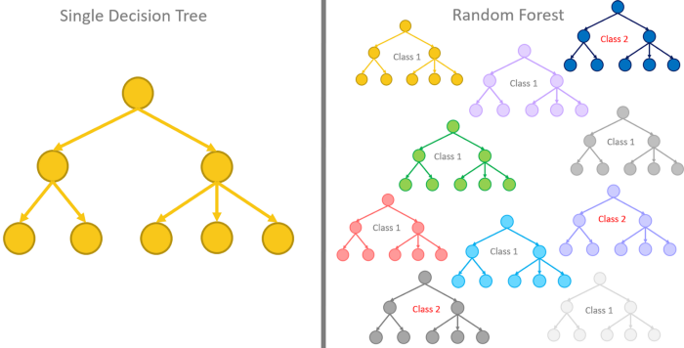
MODELING
Modeling types used: linear regression and random forests.
Linear regression
Random forest
Statistical Analysis of Airbnb Rates in New York City - Team 29

Slide 6
DATASET
What are the variables in your dataset?
Independent variables
Dependent variable: price
Why do you think this dataset is appropriate for your project?
Free, open-source
Easy to use (csv formatted)
Provided enough qualitative and quantitative details on NYC Airbnb units
Where did you get the data from? Mention the legitimate reference for your dataset
Kaggle Database, New York City Airbnb Open Data https://www.kaggle.com/dgomonov/new-york-city-airbnb-open-data/version/3?select=AB_NYC_2019.csv
neighbourhood group | neighbourhood | latitude | longitude | room type | minimum nights | number of reviews | reviews per month | calculated host listings count | availability 365
Statistical Analysis of Airbnb Rates in New York City - Team 29

Slide 7
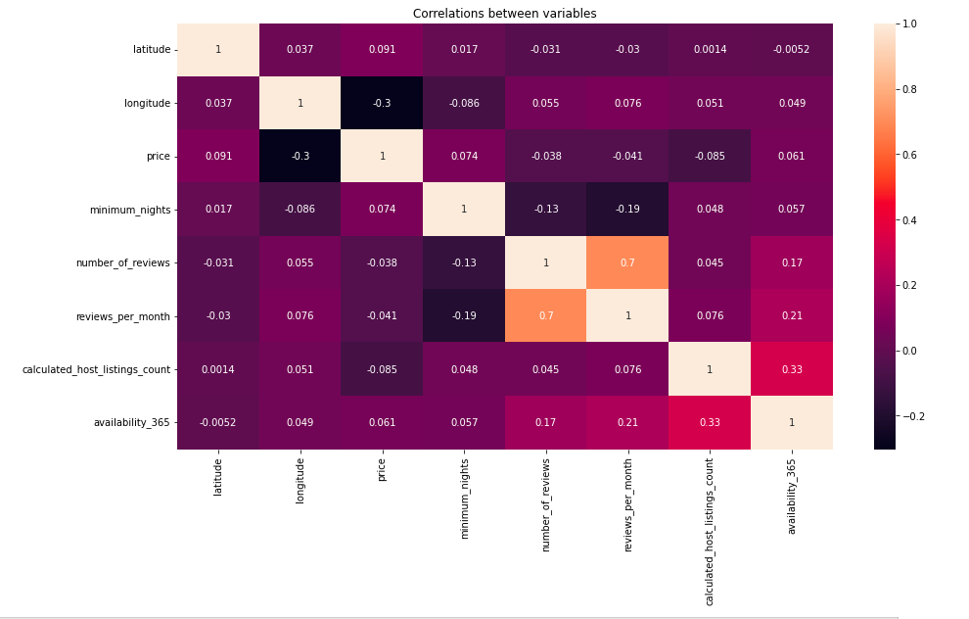
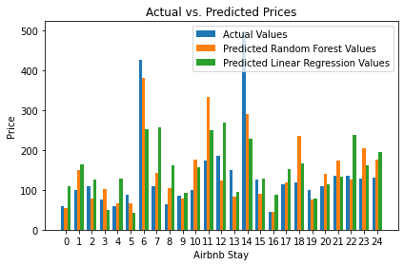
VISUALIZATION
The matrix above reveals the correlation of each variable. This matrix can help identify relevant features for Airbnbs
The bar chart reveals the differences between the actual price values of 25 random airbnbs and the two types of price values from the predicted models of individual airbnbs. This chart can help determine the accuracy of the models.
Statistical Analysis of Airbnb Rates in New York City - Team 29
Notes:
The correlation matrix displays the correlation between the various variables. The matrix can find indications of predictive relationships between the variables. The closer the values are to 1, the stronger the correlation.
The triple bar chart compares the actual and predicted prices from 25 random Airbnbs. In the bar chart we can see that the blue is the actual values, orange is predicted random forest values, and green is linear regression values. There is a higher accuracy of the random forest models versus the linear regression. However, as the actual cost goes up, the accuracy of both models drops. The results of these models will be discussed later in the presentation

Slide 8
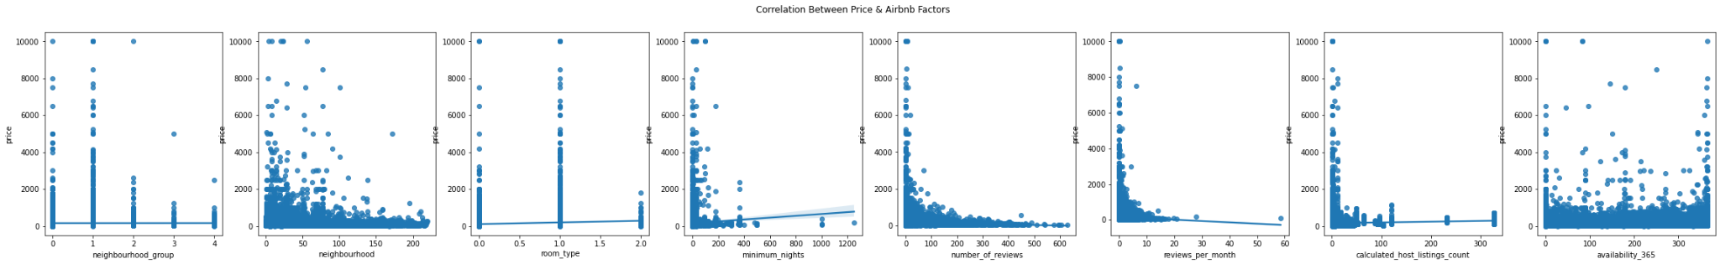
VISUALIZATION
Scatter plots illustrate and allow for observation of the relationship of some features & price.
Understanding the relationships between the features and pricing can help airbnb host to improve certain features so as to make more profit.
Statistical Analysis of Airbnb Rates in New York City - Team 29
Notes:
If we back track, the fit of the correlation matrix data is highlighted within pair plots that we generated in our code. The scatter plots here highlights the relationships or correlation between certain features (neighborhood, minimum number of nights, reviews per month) and the listing price.

Slide 9
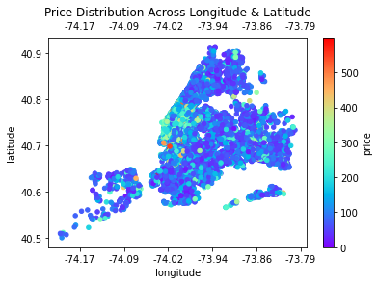
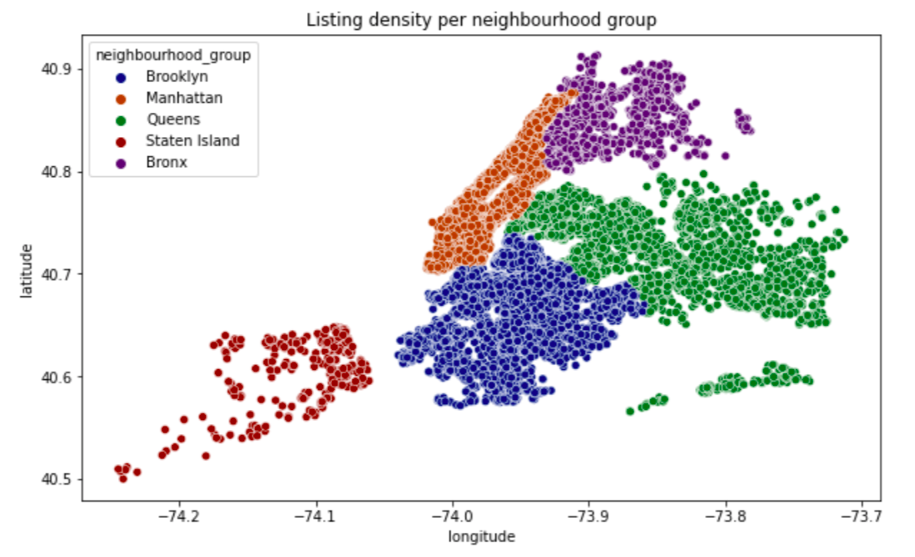
VISUALIZATION
The heat map reveals the magnitude of the effects of longitude and latitude on the pricing of Airbnb. From the map, one can see that the location can influence the pricing of Airbnbs.
The scatter plot shows the listing density of 5 neighbourhood groups or cities.
Statistical Analysis of Airbnb Rates in New York City - Team 29
Notes:
The price distribution heat scatter plot reveals the pricing throughout these areas. The redder the points are, the higher the prices. The heat scatter plot shows a concentration of higher-priced Airbnbs in the Manhattan area.
The scatter plot of density chart shows how the listings are saturated throughout New York City. Manhattan. Queens and Brooklyn have high listing density while Staten Island and Bronx do not. This result is due to some skewness in the data.

Slide 10
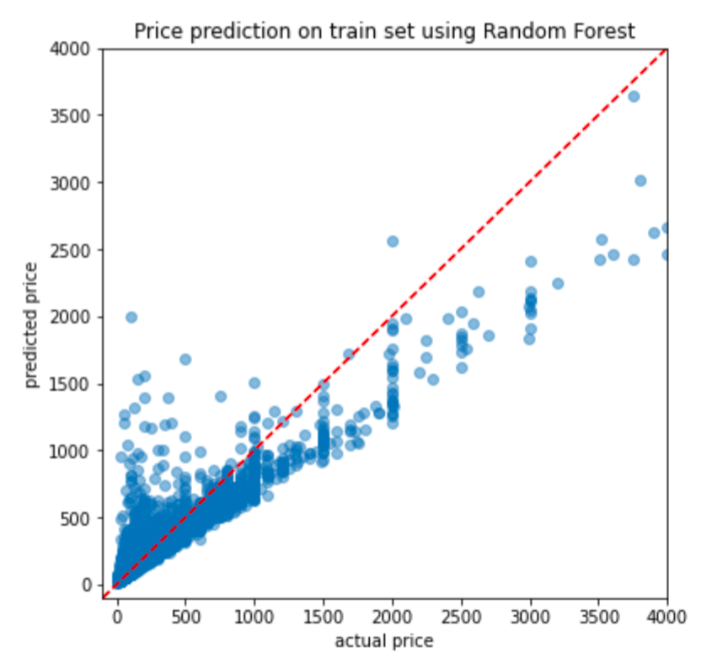
RESULTS
The random forest model was able to predict NYC Airbnb prices with the accuracy of 87%.
R^2: 0.8763909986780196
Statistical Analysis of Airbnb Rates in New York City - Team 29
Notes:
Random forest model shows the accuracy of 87%
The red diagonal line shows the perfect correlation between predict price and actual price where the model would be able to predict the correct actual price.

Slide 11
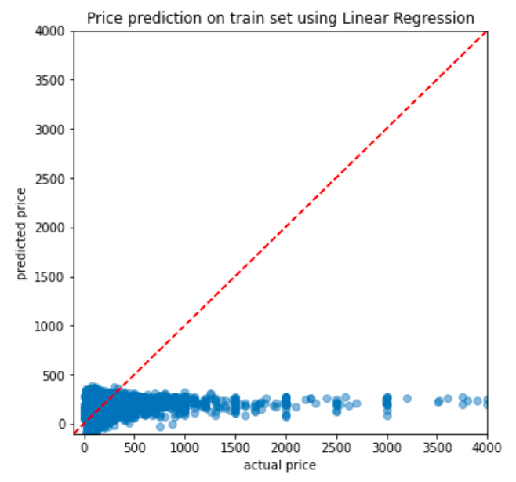
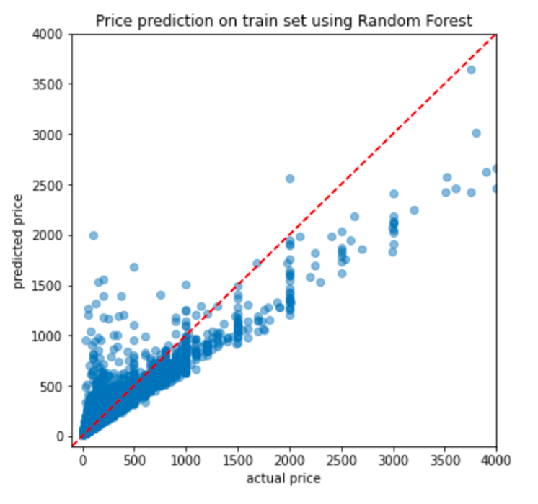
OBSERVATIONS
Linear Regression
Random forest
Statistical Analysis of Airbnb Rates in New York City - Team 29
Notes:
Tried both LR and RF but LR only yielded 6% while RF showed 87% accuracy
The more expensive the listing got, the harder it was for the graph to predict. This is true to both LR and RF models.
Random forest would be better fit because the 87%

Slide 12
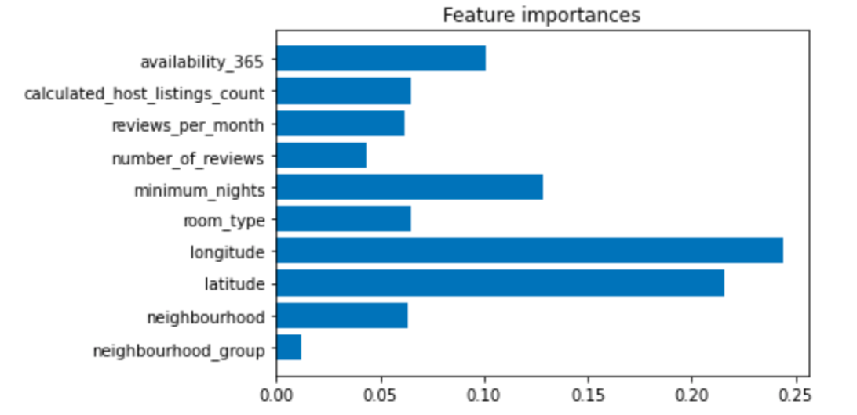
CONCLUSION
Longitudes and latitudes have heavy influences on Airbnb pricing.
Probably because of:
Downtown tourist attractions of each borough
Shorter commute to places
Statistical Analysis of Airbnb Rates in New York City - Team 29
Notes:
The bar chart above compares the importance of each feature in relation to the price.
We expected that the neighborhood and/or neighbourhood group would have heavier influence on the pricing, but we can see from the bar chart that they do not; instead the longitude and latitude were more important.
This is most likely due to tourists wanting to be close to downtown attractions and not have as far of a commute to these more attractive places.

Slide 13
REFERENCES
Guttentag, D. (2019). Progress on Airbnb: A literature review. Journal of Hospitality and Tourism Technology. https://doi.org/10.1108/jhtt-08-2018-0075.
Adamiak, C. (n.d.). Current state and development of Airbnb accommodation offer in 167 countries. Taylor & Francis. Retrieved from https://www.tandfonline.com/doi/full/10.1080/13683500.2019.1696758.
Nurdialit, D. G. (2020, October 6). Python exploratory data Analysis (EDA) on NYC Airbnb. Medium. Retrieved September 16, 2021, from https://medium.com/analytics-vidhya/python-exploratory-data-analysis-eda-on-nyc-airbnb-cbeabd622e30.
Arfiano, A. (2020, June 26). Data exploration on Airbnb singapore: 01. Medium. Retrieved September 16, 2021, from https://towardsdatascience.com/data-exploration-on-airbnb-singapore-01-40698c54cac3.k
Dgomonov. (2019, August 12). New York City airbnb open data. Kaggle. Retrieved from https://www.kaggle.com/dgomonov/new-york-city-airbnb-open-data/version/3?select=AB_NYC_2019.csv.
Statistical Analysis of Airbnb Rates in New York City - Team 29

Slide 14

Statistical Analysis of Airbnb Rates in New York City - Team 29

Slide 15
Thank you for watching!
Statistical Analysis of Airbnb Rates in New York City - Team 29

